Slide 1
Hardware Development
Tingliang Zhang
The Future Laboratory, Tsinghua University

Slide 2
Outline
What is Hardware Development
A thorough introduction of Microcontrollers
How to develop any prototype
A list of what we need to learn
Discussion about of hardware engineering

Slide 3
Hardware Development

Slide 4
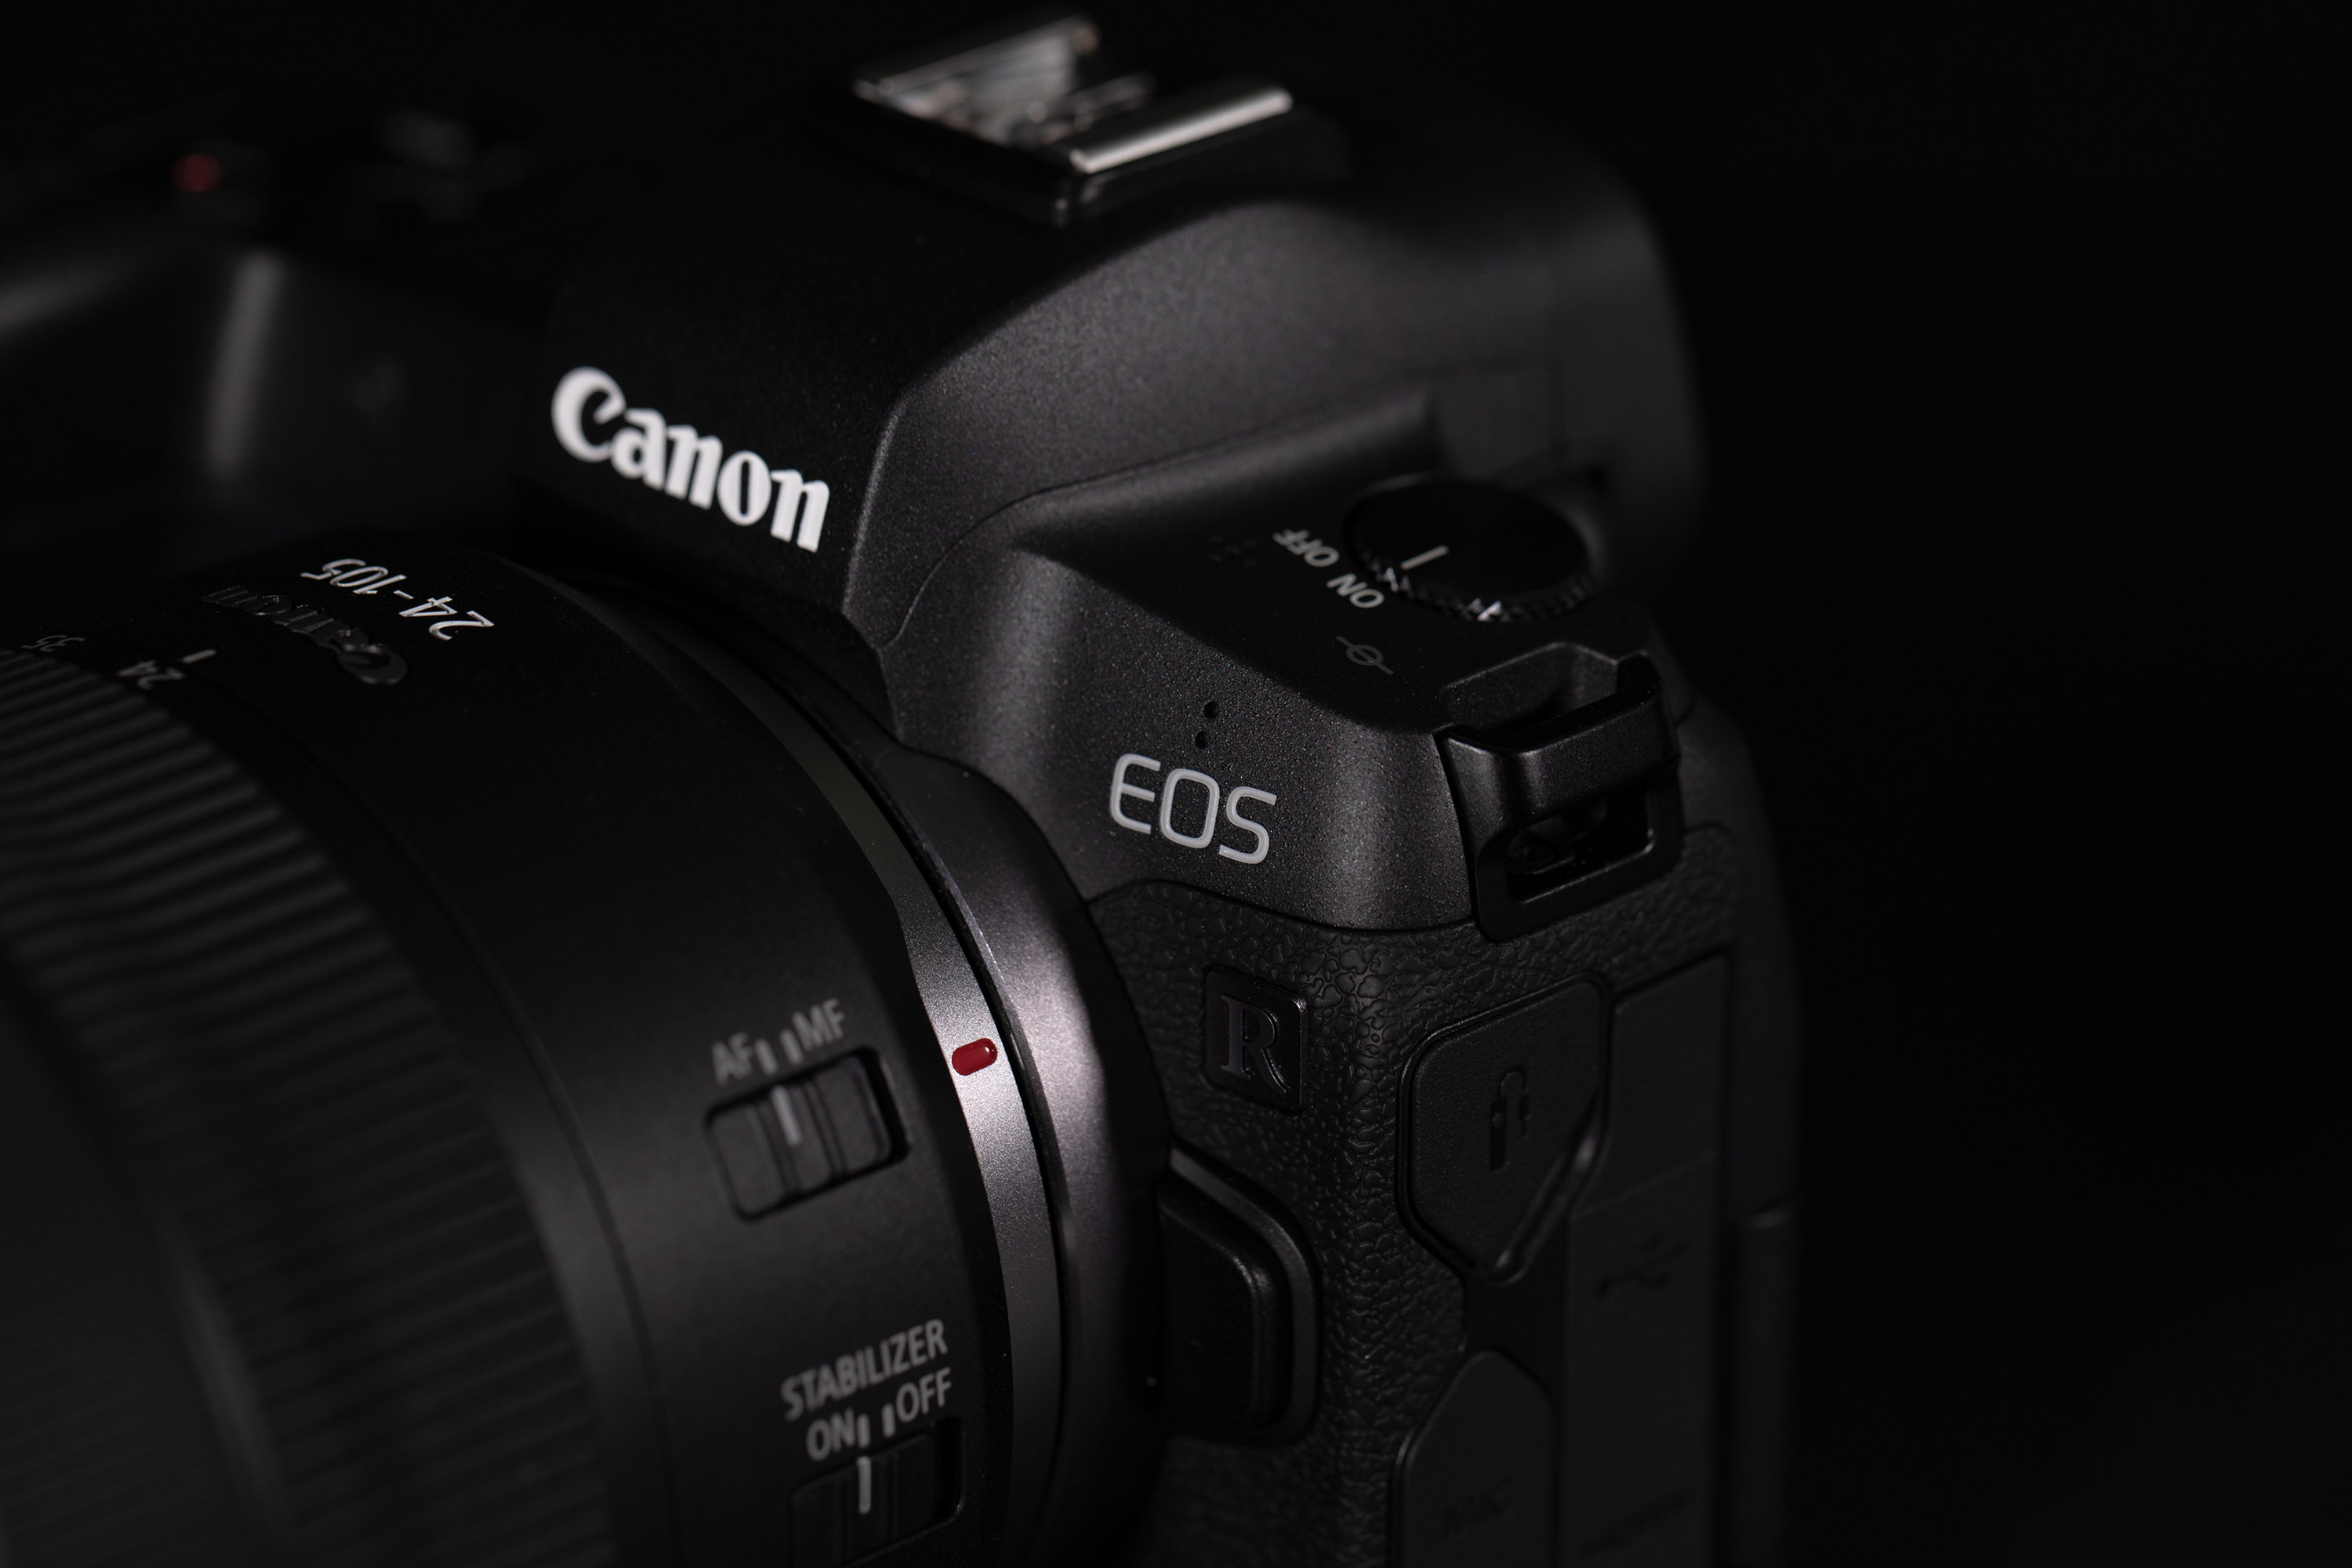
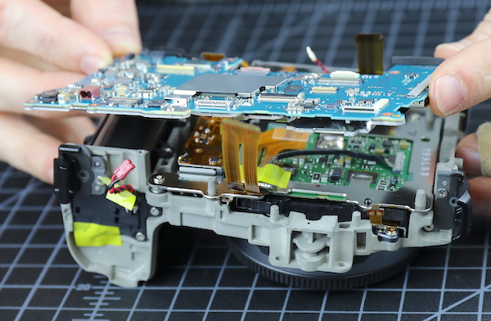

Slide 5
Microcontroller
The center of Hardware Development

Slide 6
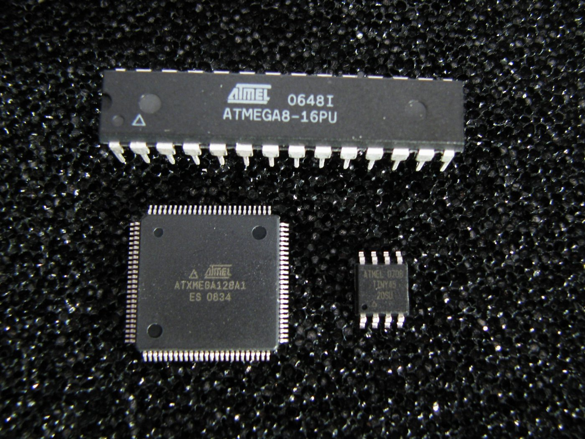
What is a microcontroller?
Microcontrollers are single chip computers that include a minimum of a microprocessor, memory, and input-output module.

Slide 7
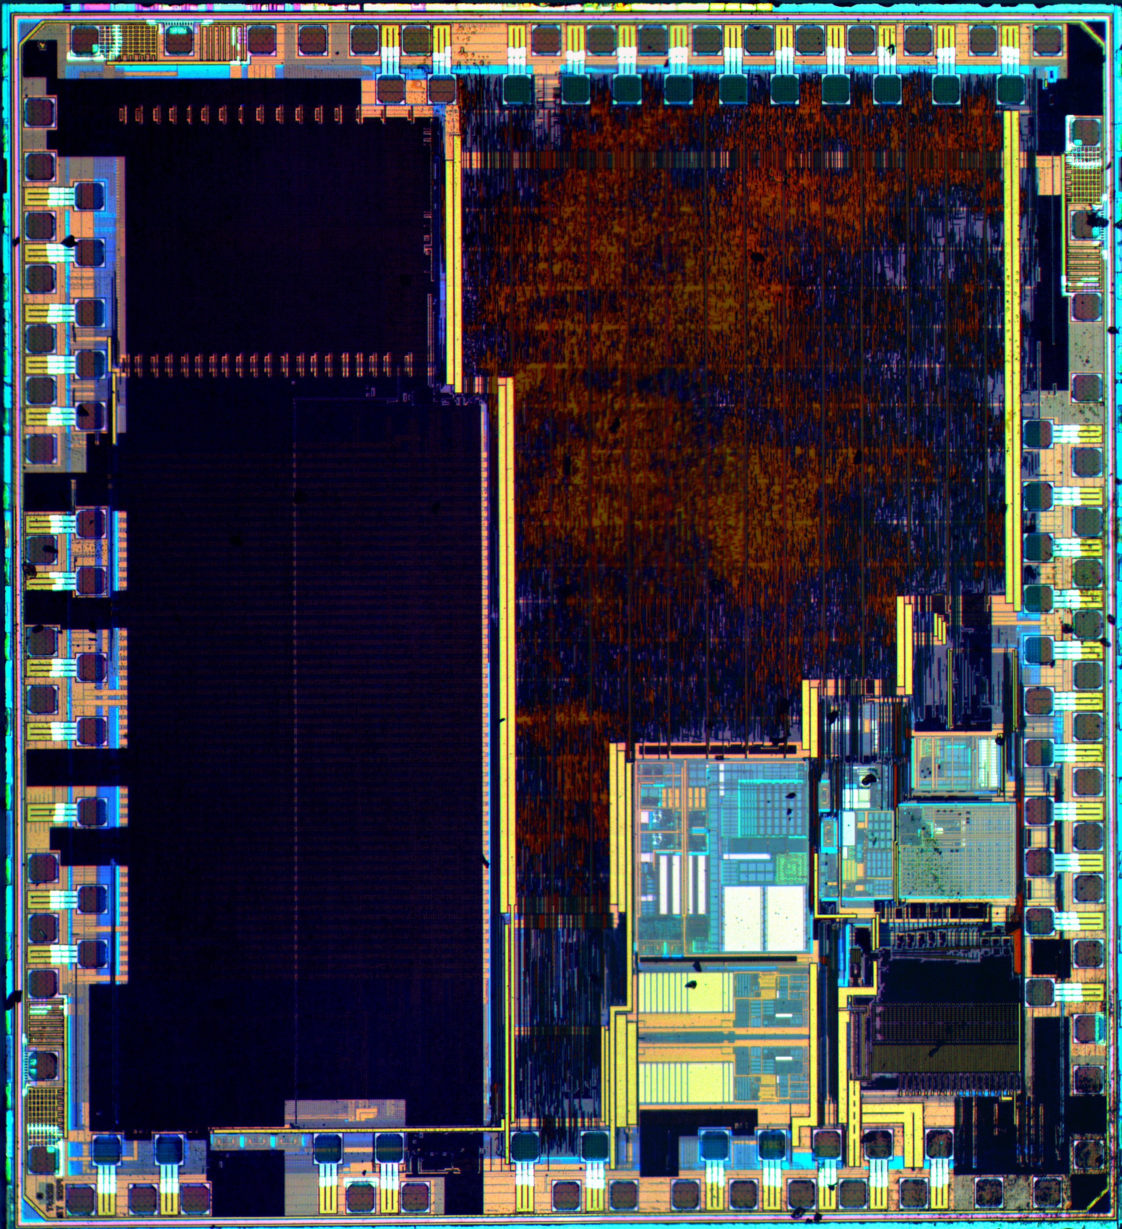
The differences between a microprocessor and a microcontroller.
a microprocessor requires several additional external support chips such as memory and input-output circuits

Slide 8
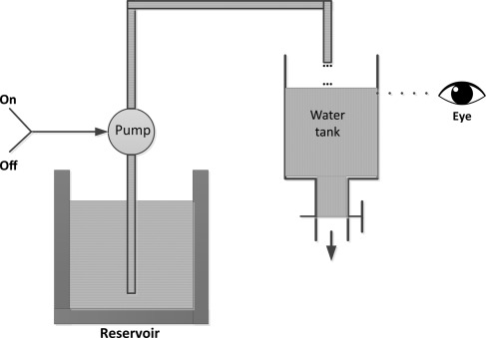
The example of liquid level control system. Fig.1

Slide 9
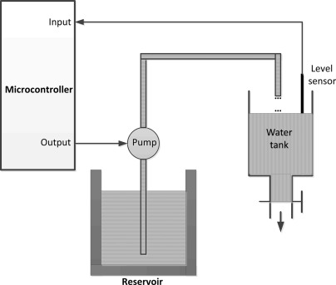
Fig.2

Slide 10
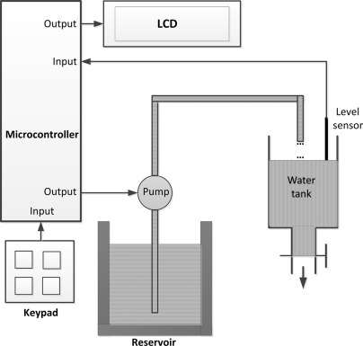
Fig.3

Slide 11
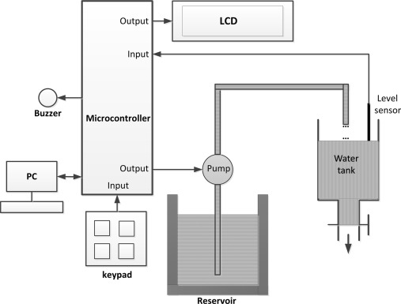
Fig.4

Slide 12
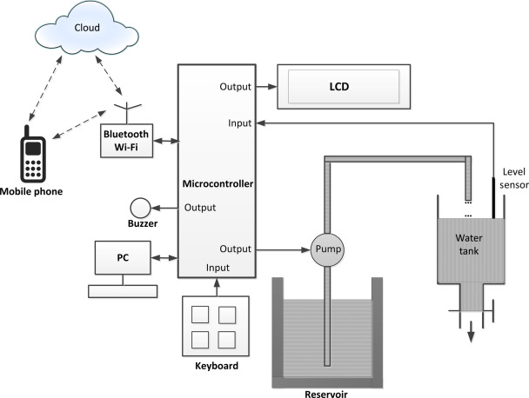
Fig.5

Slide 13
Develop Prototype

Slide 14
How to develop any prototype
- A brief IDEA about any non-pure-software stuff
- Split the function into a few small function
- Decide use which model to achieve each function
- Buy lots of stuff from Taobao, JLC
- Build the prototype
- Test and Debug
- Iteration

Slide 15
Skills needed

Slide 16
A list of what we need to learn
1. Dev boards such as Arduino and STM32;
2. Communication protocol such as UART, SPI, I2C, and RS232;
3. Programming languages including C, Python, Java, C++, Verilog;
4. Debug tools such as oscilloscope, waveform generator, multimeter;
5. Peripherals(外设) like brushless motor, servo motor, stepper motor, microphone, IMU, display;
6. Circuits simulate and PCB design tools: Multisim, KiCAD, Altium Designer;
7. Soldering and SMT: QFNP, QFP, BGA, DIP......JLC
8. Algorithms: FFT, PID

Slide 17
The Future

